Slide 1

Design of Breathalyzer for Non-Invasive Diagnosis of Tuberculosis
.
TEAM MEMBERS:
ILLAYABOOPATHY U [210421121018]
PRIYA DHARSHAN D [210421121035]
VIGNESH RAJ S [210421121058]

Slide 2
Problem Statement
Tuberculosis remains a global health threat killing over 1 million people per year
A diagnostic procedure of TB by skin or blood provides minimal information about the TB bacteria and does not provide quantitative information on the disease progression.
To identify latent TB infection (LTBI) in a patient either a sample of sputum or chest
X-ray is currently used.
To reduce TB incidence and mortality, there is a continuous need for lower cost, simpler and more robust means of diagnosis. One method that may fulfil these requirements is in the area of breath analysis.
Our idea focuses on the diagnosis of tuberculosis by the change in breath components using gas sensors in a portable breathalyzer.

Slide 3
Literature Review
Sl. No | Title of the Paper | Authors | Name of the Journal, Year, Volume, Issue | Observation
1 | Breath Analysis in Disease Diagnosis: Methodological Considerations and Applications | Célia Lourenço and Claire Turner* | Pub Med Central Metabolites. 2014 Jun; 4(2): 465–498. Published online 2014 Jun 20. doi: 10.3390/metabo4020465 | The idea proposed in this journal was to firstcollect samples and the methodology PTR, VOC tests was described,challenges behind the model was explained’
2 | Diagnosis of tuberculosis through breath test: A systematic review | Antonia M.I.SaktiawatiabcDavid DwiPuteradAlthafSetyawaneYodiMahendradhatacfTjip S.van der Werfbg | EBioMedicine Volume 46, August 2019, Pages 202-214 | The work was performed on a dataset of diagnosis of TB through a breathe test and clinicsl studies was made
3 | Tuberculosis Diagnostics, a journey from the past Experiences to the Future Directions | Swathy Moorthy1 Emmanuel Bhaskar2 Shivakumar S3 and Santhi Silambanan | AGJSR 39 (2) 2021: 82-99 | This journal proposes the Tuberculosis analysis method and diagnosis process from the past to the current method and the technology used and the experience which has made the result for future preference

Slide 4
Literature Review
Sl. No | Title of the Paper | Authors | Name of the Journal, Year, Volume, Issue | Observation
4 | Breath biomarkers of active pulmonary tuberculosis | Michael Phillips 1, Victoria Basa-Dalay, Graham Bothamley, Renee N Cataneo, Phung Kim Lam, Maria Piedad R Natividad, Peter Schmitt, James Wai | Tuberculosis (Edinb) .2020 Mar;90(2):145-51. doi: 10.1016/j.tube.2010.01.003. Epub 2020Feb 26. | This paper proposed a identification of Volatile organic compounds (VOCs) in breath may contain biomarkers of active pulmonary tuberculosis derived from the infectious organism
5 | A simple breath test for tuberculosis using ion mobility: A pilot study | Amandip S. Sahota Ravi Gowda b Ramesh P. Arasaradnam c Emma Daulton | Elsevier Health Article March 2019(Tuberculosis 99 (2019) 143e146) | The workflow for performing the breathe test for tuberculosis using Ion Mobility Spectrometry (IMS) in particular, has potential as a technology that can be applied to breath testing for clinical diseases including TB.

Slide 5
Existing System
THE PATIENT COUGHS INTO THE COLLECTION TUBE, AT THE BOTTOM OF WHICH IS A GLASS BIO-SENSOR.
TB BREATH TEST IS UNDERTAKEN IN INTEGRATED SYSTEM HAS SINGLE-USE DISPOSABLE SAMPLE COLLECTION TUBE
THE LASER DETECTS THIS SIGNAL CHANGE AND THE UNIT RETURNS A POSITIVE RESULT.
THE TUBE IS THEN INSERTED INTO THE READER AND TWISTED TO SWITCH ON THE UNIT.
AFTER READING AND ANALYSIS THE SAMPLE TUBE IS DESTROYED

Slide 6
Proposed System
CHOOSING A SUITABLE
VOC GAS SENSOR
SIMULATE& DESIGN A SUITABLE CHAMBER
COLLECT THE RESPONSE FROM HEALTHY &AFFECTED
DEVELOPE A PORTABLE ANALYSER
MAKING RECORD OF VOC THROUGH AN APP

Slide 7
Working
Portable tool is used to kit development .
ESP32 Controller – Power and Program the chip, connect it to mobile phone or laptop pins , connect peripherals ,built in power and for antenna for wi-fi is connected with power adaptor.
DHT 22 Sensor – Measure the surrounding air and spits out a digital on the data pin(no analog input pins needed).
The SGP40 VOC Sensor is a digital VOC (Volatile Organic Compounds) sensor module that incorporates SGP40, designed for air quality monitoring.
Serial Bluetooth Terminal(version 1.40) – all this components are connected and the level of VOC , Temperature, Humidity were display in the application.
The accurate rate of VOC level helps to determine the presence of Tb bacteria.

Slide 8
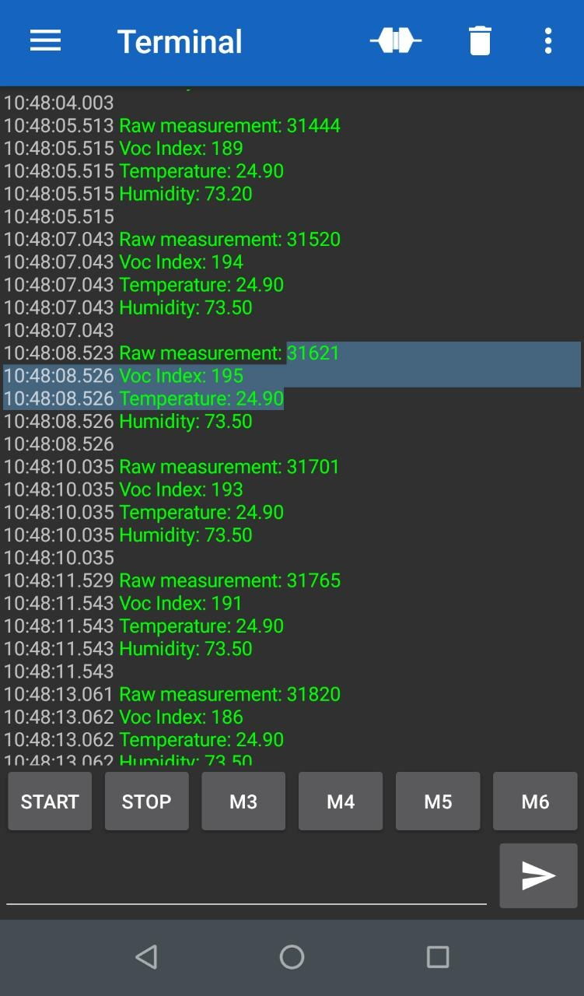
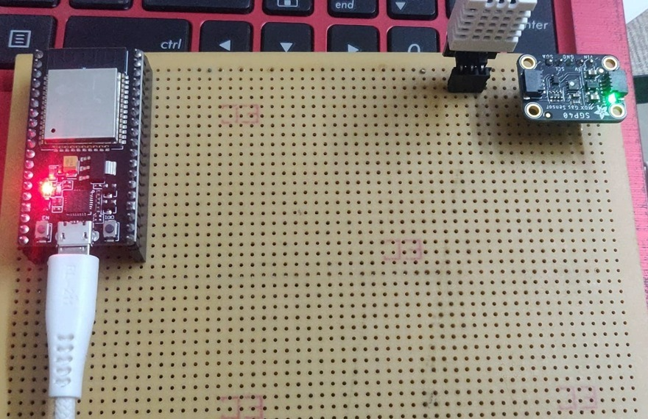
Photosnap of Project

Slide 9
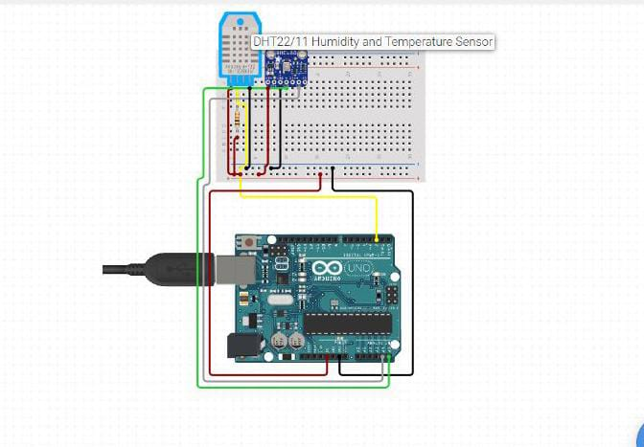
Circuit Diagram

Slide 10
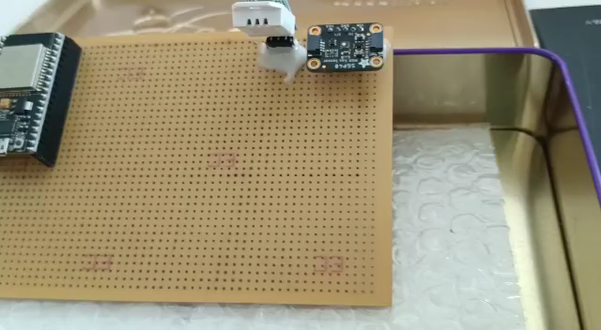
Working Video of Project
https://drive.google.com/file/d/1CwfKgh0elMHLH55lROcJJ-CkprgXqwCq/view?usp=share_link

Slide 11
Result and Discussion
The study evaluated the accuracy of the device in detecting TB in patients with confirmed TB infection and those without TB infection.
The study evaluated the accuracy of the device in detecting TB in patients with confirmed TB infection and those without TB infection.
However, further research is needed to evaluate the accuracy and reliability of these devices, particularly in different populations and settings. It is also important to consider the cost-effectiveness of TB breath analyzers compared to traditional diagnostic methods.

Slide 12
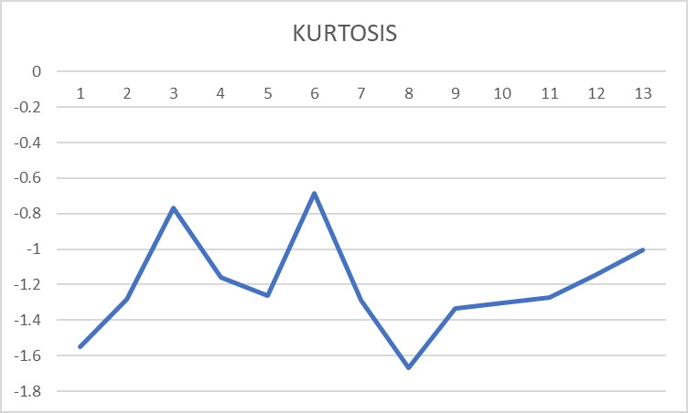
GRAPH- KURTOSIS VALUE FOR TB
The graph describes the Kurtosis value for each TB People
The X coordinates for number of patient and the Y coordinates for the Kurtosis value of VOC level.
Kurtosis, on the other hand, is a measure of the degree of peak of a distribution.
The kurtosis value occurs in range highest -1.0047 and lowest is -1.6703
The graph helps to determine the further accuracy level.

Slide 13
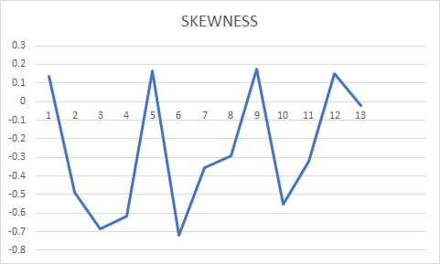
GRAPH- SKEWNESS VALUE FOR TB
The graph describes the Skewness value for each TB People
The X coordinates for number of patient and the Y coordinates for the Skewness value of VOC level.
Skewness is a measure of the degree of asymmetry of a distribution.
The Skewness range is plotted and in range max 0.1744 and -0.61712
The graph helps to determine the further accuracy level.

Slide 14
Application
Significantly reduce workplace accidents and safety hazards.
Used to diagnose the patient at early stage in easy manner
Breath analysis for TB diagnosis could be developed as a point-of-care testing tool, meaning it could be performed on-site, without the need for laboratory equipment or specialized personnel.
Reduce the Patient Time to wait for the result.
Easy prediction.

Slide 15
Future work
Fabrication of the mass production facemask to identify tuberculosis by retrofitting sensor to affordable industrial face masks.
To enhance the technique for the future prediction.
To develop the production of mask with cost effective portable kit
The employment of ensemble machine learning algorithm to accurately identify the presence of tuberculosis infection in a person based on the sensor reading.

Slide 16
Reference
[1] World Health Organisation. WHO consolidated guidelines on tuberculosis: tuberculosis preventive treatment:
Module 1: prevention. Geneva, World Health Organisation, 2020.
[2] Kim K-H, Jahan SA, Kabir E. A review of breath analysis for diagnosis of human health. TrAC Trends Anal Chem 2012;33:1e8.
[3] Kolk AHJ, Van Berkel JJBN, Claassens MM, Walters E, Kuijper S, Dallinga JW,Van Schooten FJ. Breath analysis as a potential diagnostic tool for tuberculosis.Int J Tuberc Lung Dis 2012;16(6):777e82.
[4] Phillips M, Cataneo RN, Condos R, Erickson GAR, Greenberg J, La Bombardi V,Munawar MI, Tietje O. Volatile biomarkers of pulmonary tuberculosis in the
breath. Tuberculosis 2007;87(1):44e52.
[5] Bruins M, Rahim Z, Bos A, van de Sande WWJ, PhEndtz H, van Belkum A.
Diagnosis of active tuberculosis by e-nose analysis of exhaled air. Tuberculosis
2013;93(2):232e8.

Slide 17


